Slide 1
FARMING AGENT
IBM AICTE PROJECT
Presented By:
Student name :Debashis Goswami
College Name : Bengal College of Engineering and Technology
Department: CSE

Slide 2
OUTLINE
Problem Statement
Technology used
Wow factor
End users
Result
Conclusion
Github Link
Future scope
IBM Certifications

Slide 3
PROBLEM STATEMENT
Researchers, students, and professionals often struggle to stay updated with the rapidly growing volume of academic publications, technical articles, datasets, and evolving research trends. Manually reviewing, filtering, and synthesizing information across multiple domains is time-consuming and inefficient.
Proposed Solution: An AI Research Agent that uses Natural Language Processing (NLP), Retrieval-Augmented Generation (RAG), to assist users in conducting efficient literature reviews, generating summaries, identifying research gaps, and recommending relevant papers, datasets, or collaborators.

Slide 4
TECHNOLOGY USED
IBM cloud lite services
Natural Language Processing (NLP)
Retrieval Augmented Generation (RAG)
IBM Granite model

Slide 5
IBM CLOUD SERVICES USED
IBM Cloud Watsonx AI Studio
IBM Cloud Watsonx AI runtime
IBM Cloud Agent Lab
IBM Granite foundation model

Slide 6
WOW FACTORS
This agent empowers farmers, agronomists, and agri-startups by dramatically reducing the time spent on crop planning, pest identification, and yield optimization. It transforms complex agricultural data into real-time, actionable insights — enabling smarter, faster, and more sustainable farming decisions.
Unique features:
Semantic search across research papers, journals, and datasets
Auto-summarization of selected papers
Citation and reference analysis to trace influence
Recommendation of research papers based on a user’s current topic
Trend analysis over time for specific keywords or domains.
Collaboration mapping: suggests potential co-authors or institutions based on similar research interests.

Slide 7
END USERS
Academic Researchers
Research Institutions and Universities
Industry R&D Teams
Educators

Slide 8
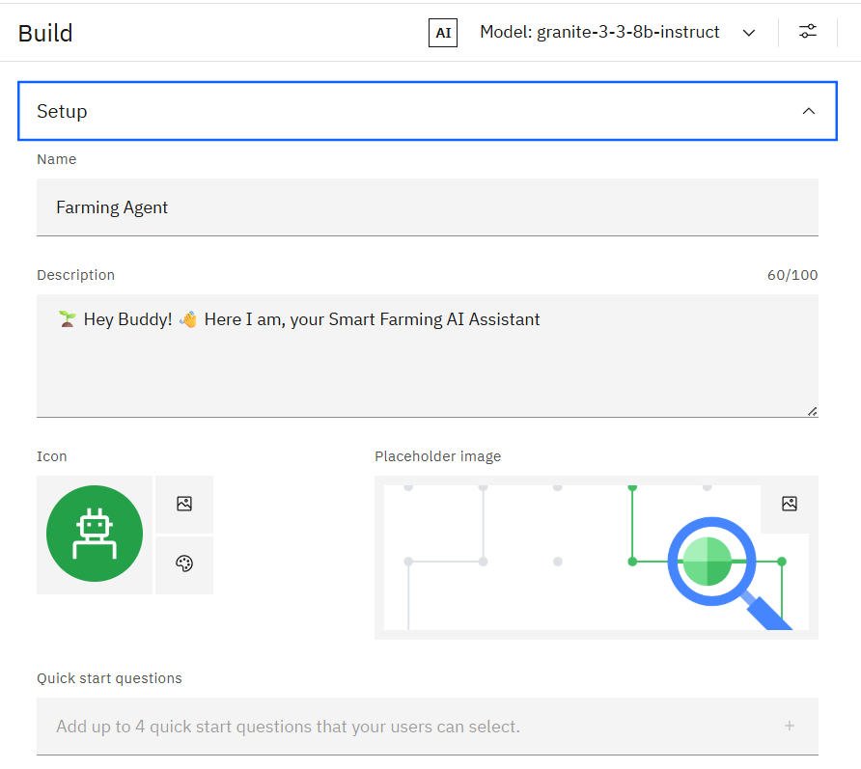
Setup

Slide 9
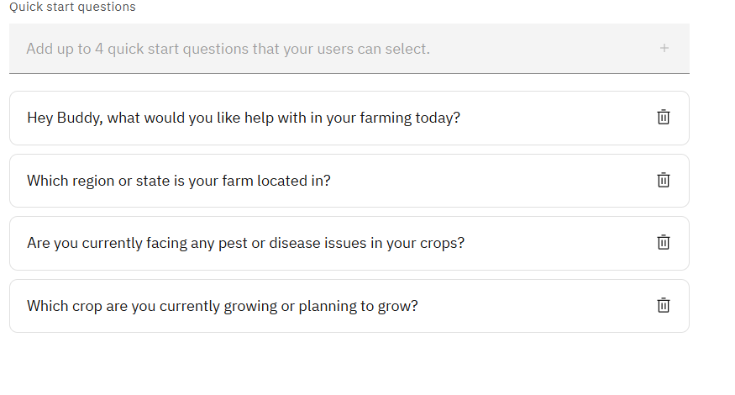
Suggested Prompts

Slide 10
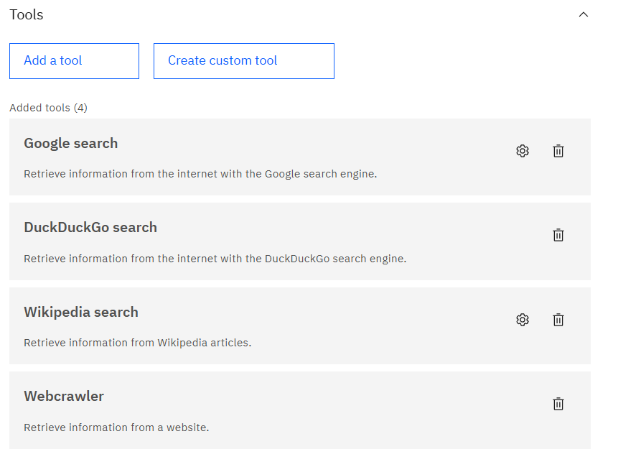
Tools And Testing

Slide 11
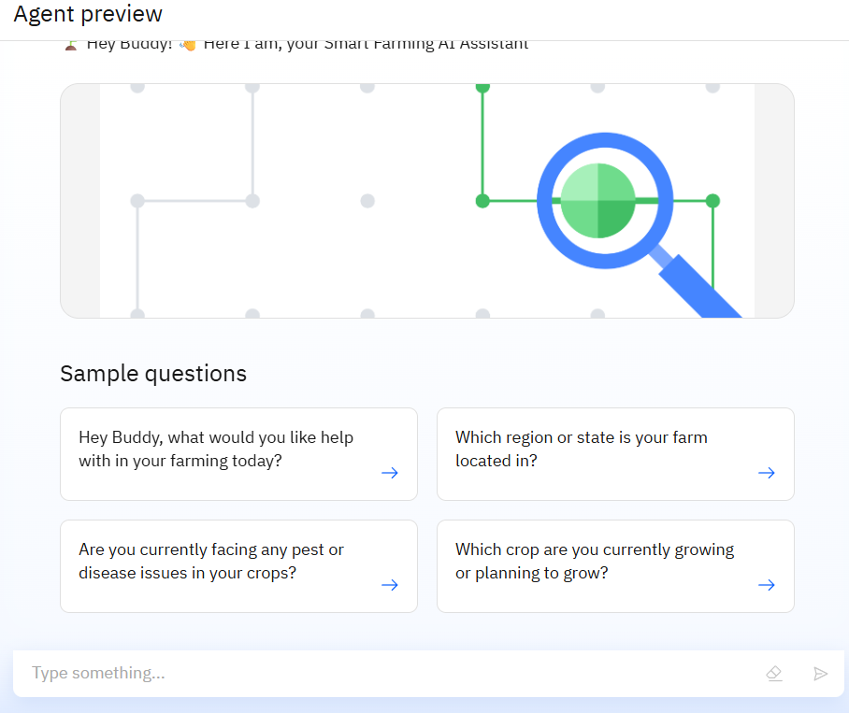
RESULTS

Slide 12
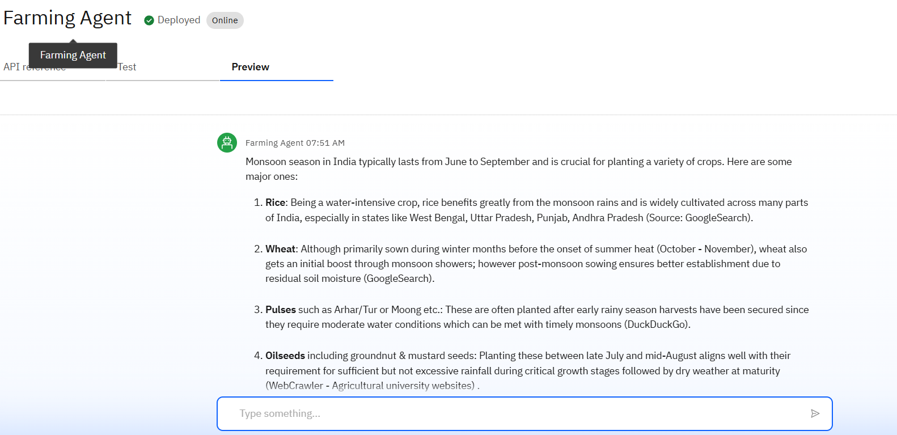
RESULTS

Slide 13
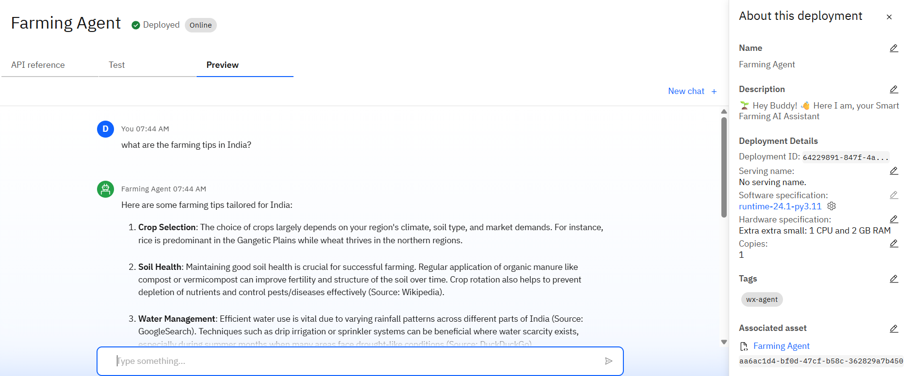
RESULTS

Slide 14
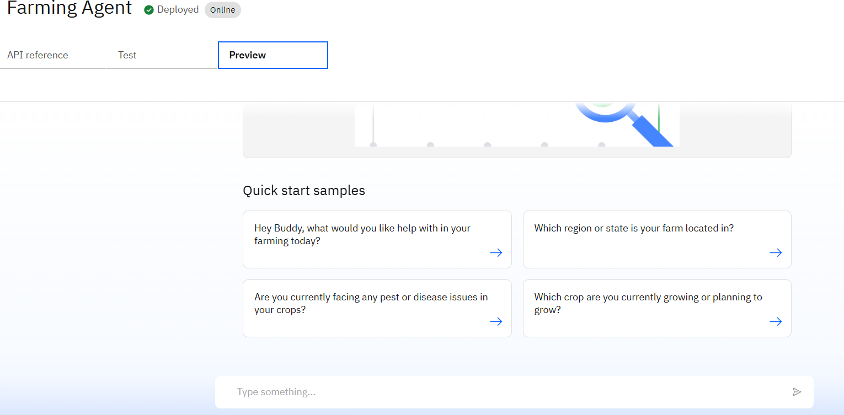
RESULTS
Deployed AI Agent

Slide 15
CONCLUSION
The agent can generate personalized crop plans, detect potential threats, and deliver precise farming recommendations tailored to each region and season.
It saves time by automating repetitive agricultural tasks such as pest diagnosis, weather tracking, and irrigation planning.
Farming AI Agents enhance productivity, sustainability, and profitability across all levels of agriculture — from smallholder farms to large-scale agribusiness operations.

Slide 16
FUTURE SCOPE
Multilingual Research Support
Voice-Activated Research Assistant
Real-Time Collaboration Features
Research Gap and Novel Topic Identification
Integration with Publishing Platforms
AI-Assisted Paper Drafting

Slide 17
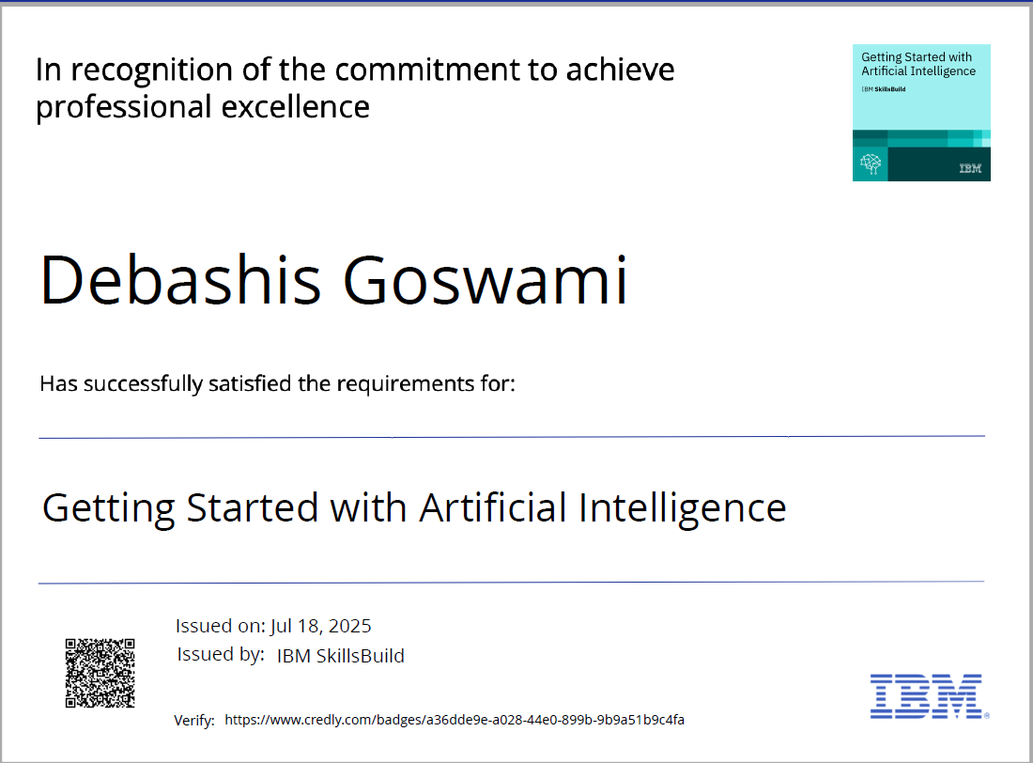
IBM CERTIFICATIONS

Slide 18
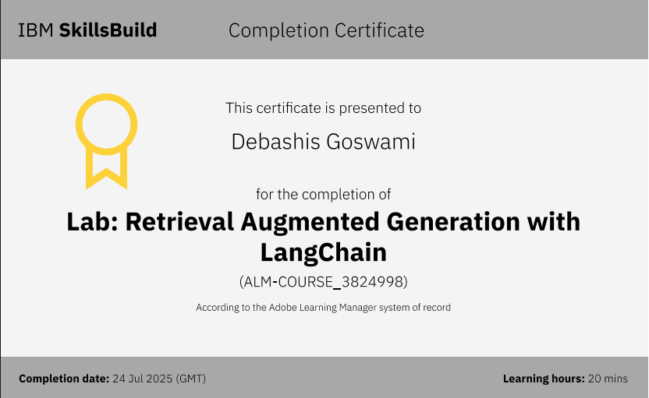
IBM CERTIFICATIONS

Slide 19
Github link : https://github.com/Bittu3487/IBM-Cloud-Farming-Agent

Slide 20
THANK YOU

